Slide 1
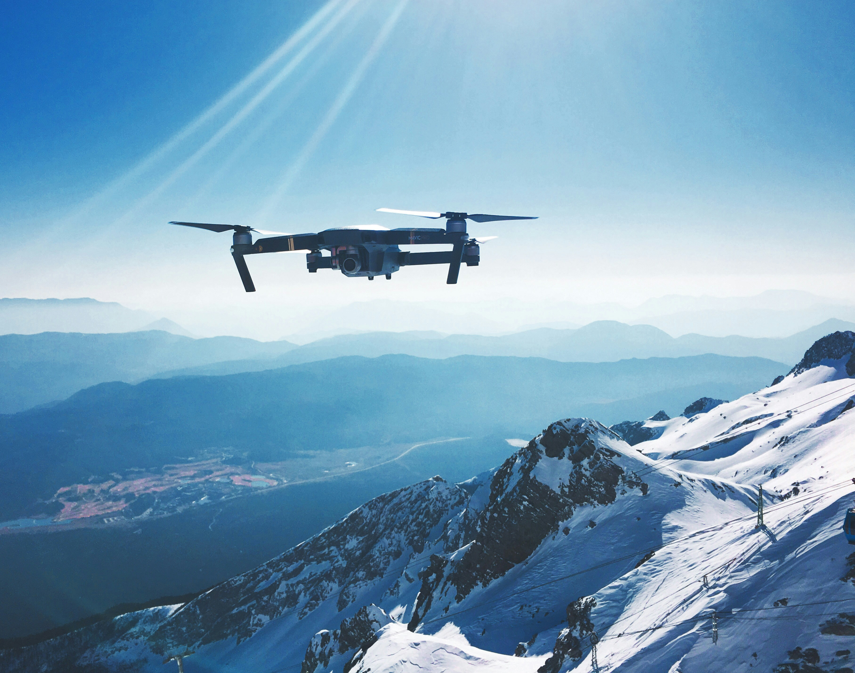

Localization of Avalanche Victims by a Team
of UAVs
Department of Computer, Control and Management Engineering
”Antonio Ruberti”
Master in Artificial Intelligence and Robotics
Candidate: Antonio Scardino, 2020613
Thesis Advisor: Prof. Andrea Cristofaro

Slide 2
INTRODUCTION
Robots support has become more and more extensive in recent years, in the context of S&R operations.
A particular field of S&R missions focuses on high mountain scenarios, in which UAVs are tasked with localizing avalanche victims.
Demanding time constraint: victims have 93% survival rate within the first 15 min, which drops to 25% after 45 min due to hypothermia.
Electromagnetic sensors are most accurate, fastest and can operate in noisy environments. ARTVAs are most used in both human and robot-conducted operations; they operate at 457 kHz and have a maximum range of 80 m ca. (3 antennas).

Slide 3


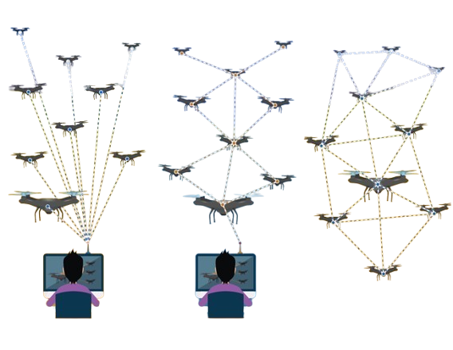
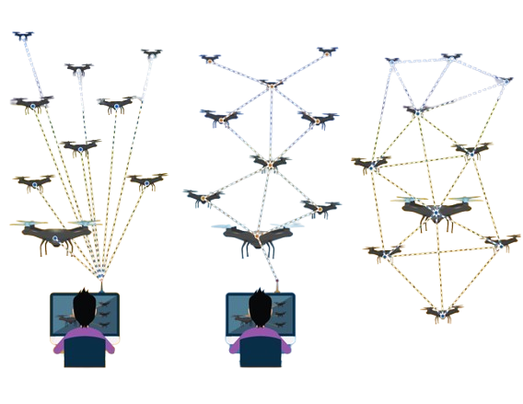

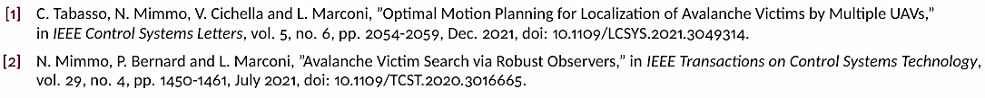
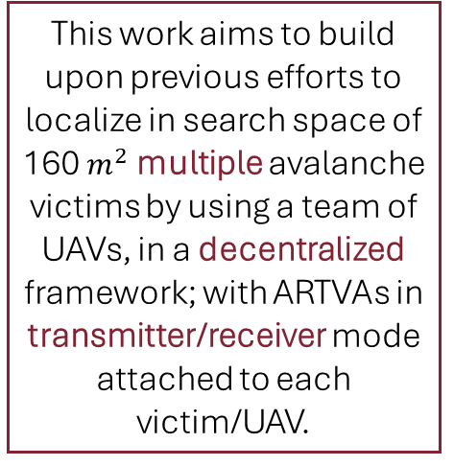
PROBLEM STATEMENT
Centralized
Decentralized
(Fully autonomous)
Authors of [1][2] have formulated a strategy to localize a single avalanche victim using multiple UAVs, in a centralized framework. They employ the RLS algorithm to estimate the position and generate trajectories for the UAVs to follow.
This work aims to build upon previous efforts to localize in search space of 160${ m}^{2}$ multiple avalanche victims by using a team of UAVs, in a decentralized framework; with ARTVAs in transmitter/receiver mode attached to each victim/UAV.

Slide 4
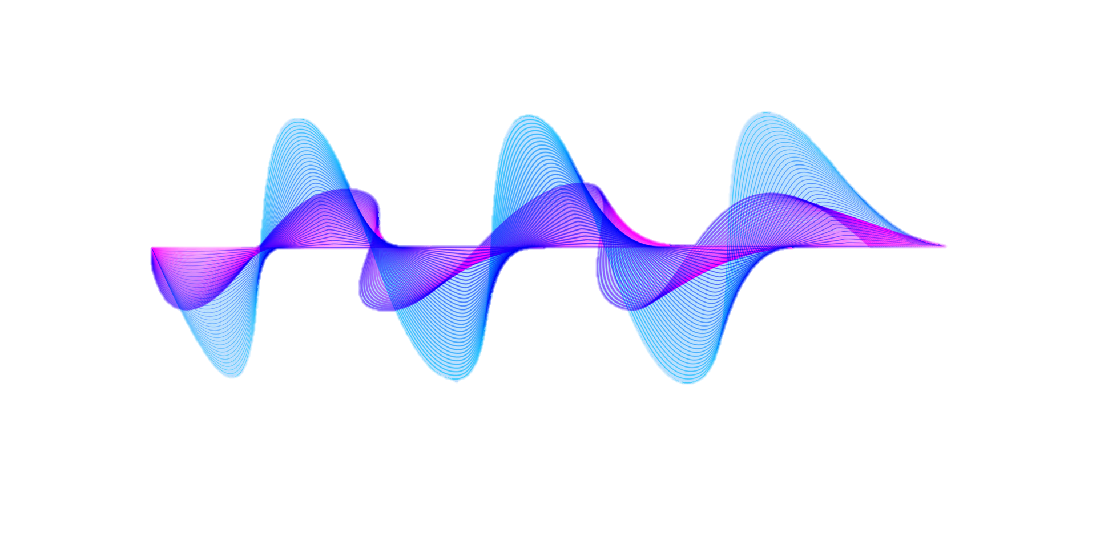
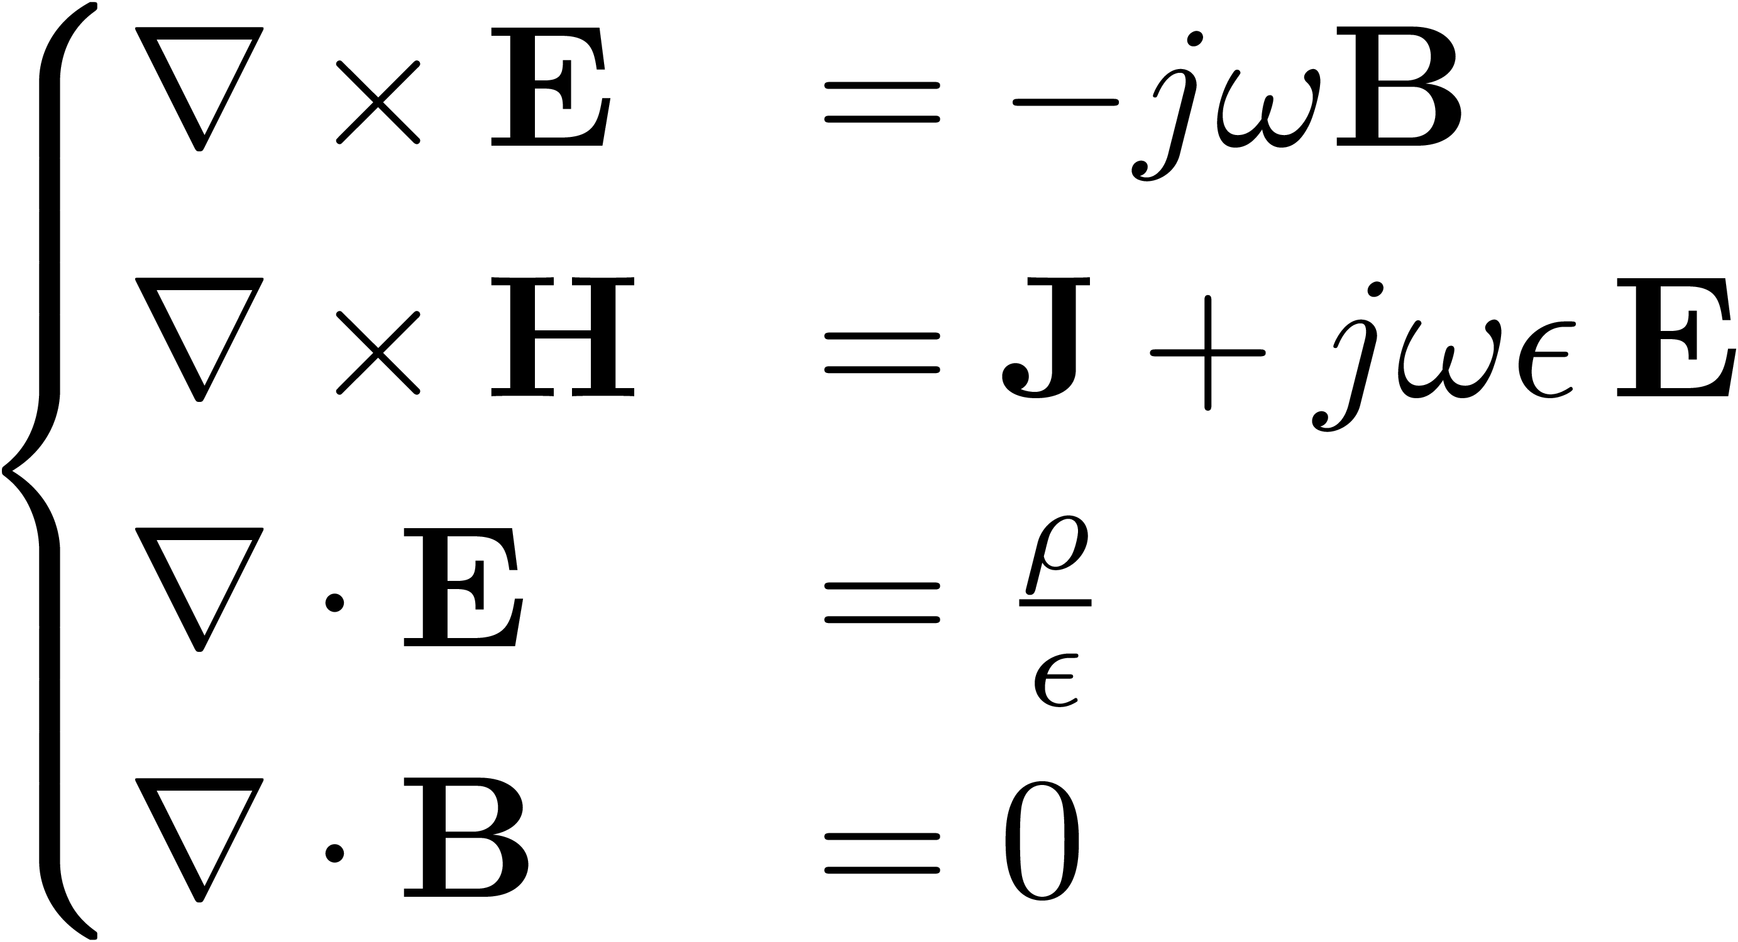
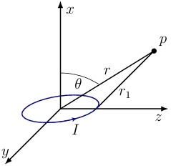
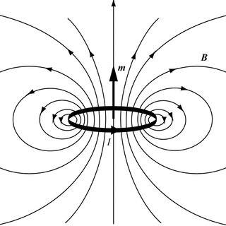
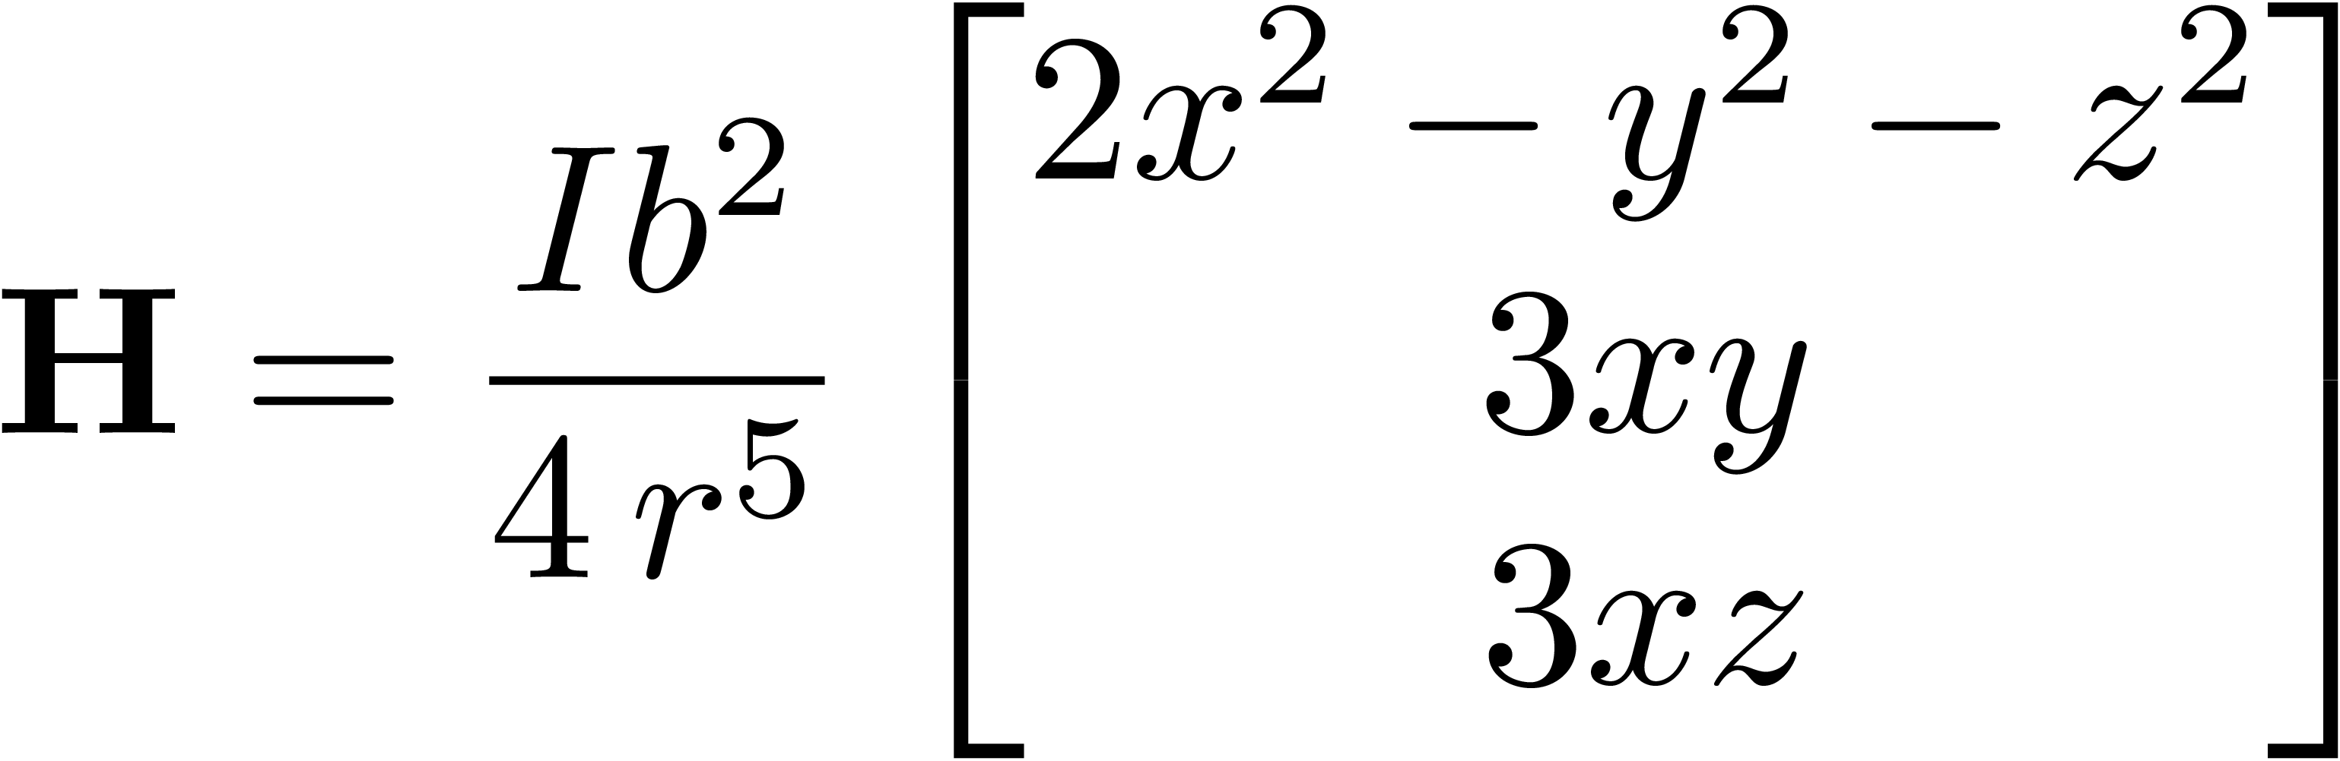
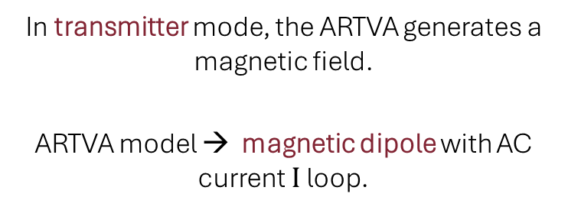
SINGLE VICTIM
Maxwell Equations
In transmitter mode, the ARTVA generates a magnetic field.
ARTVA model → magnetic dipole with AC current $I$ loop.
Quasi-Static Field/Near Field Zone Assumption
Magnetic Field Intensity
Notes:
Asusntion quasi static meaning the wavelength is bigger than the distance between p and origin

Slide 5

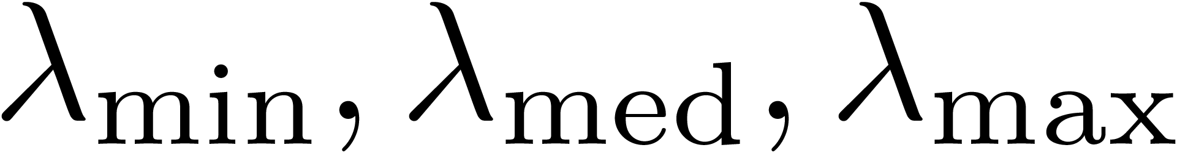

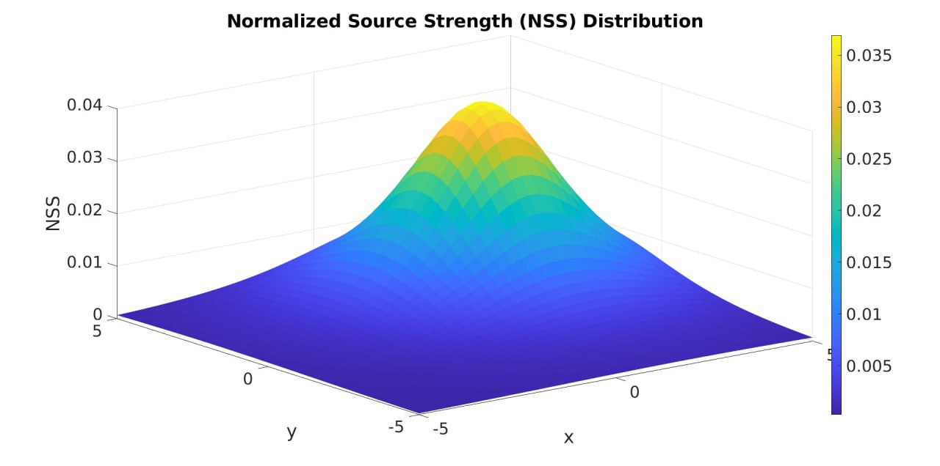
Find eigenvalues of
Signal becomes the
SINGLE VICTIM
Magnetic Gradient Tensor

Slide 6
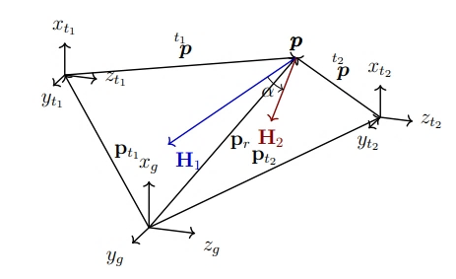
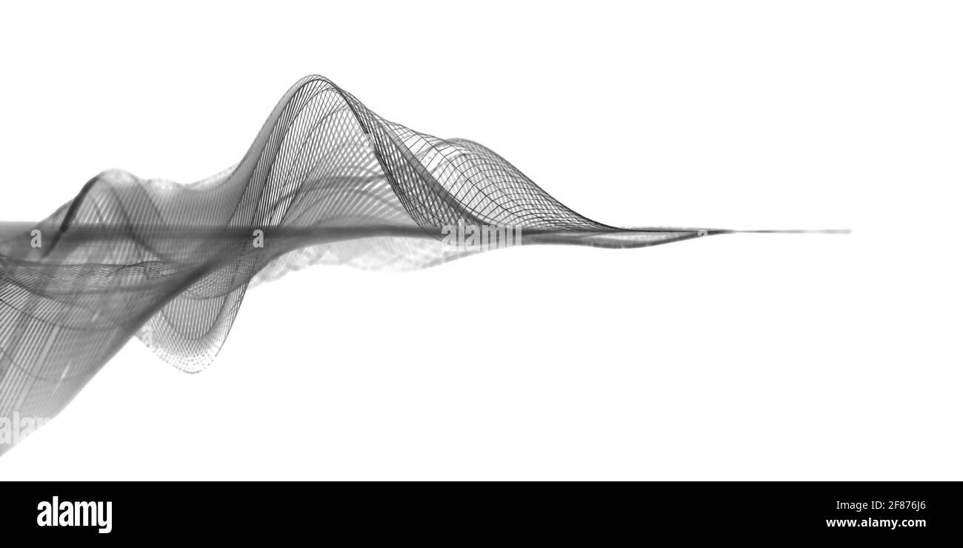
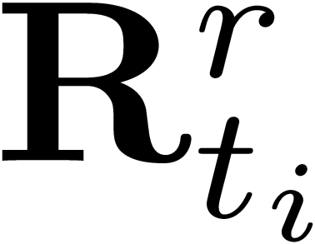
MULTIPLE VICTIMS
Superposition of multiple signals:
Magnetic field intensity depends on rotations.
Note: Hovering UAVs → time invariant.
Eigenvalues of determine the total NSS value received by each UAV.
Notes:
Quasi hovering

Slide 7
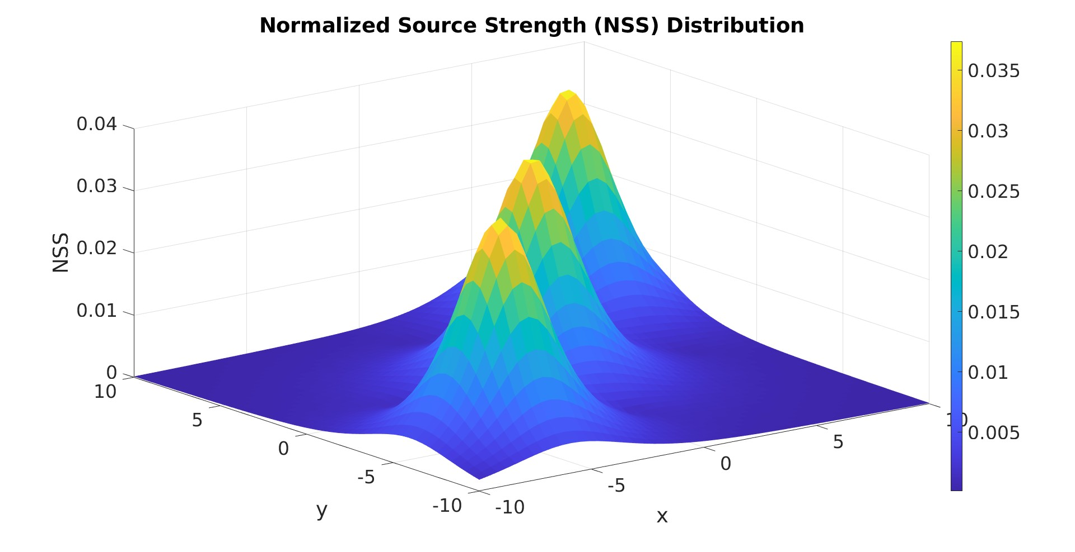


NSS ANALYSIS
Property → the NSS is rotationally invariant, also with multiple sources.
Reference frames not rotated
Rotations $R_{t_{i}}^{r}$ $R_{t_{i}}^{g}$considered

Slide 8
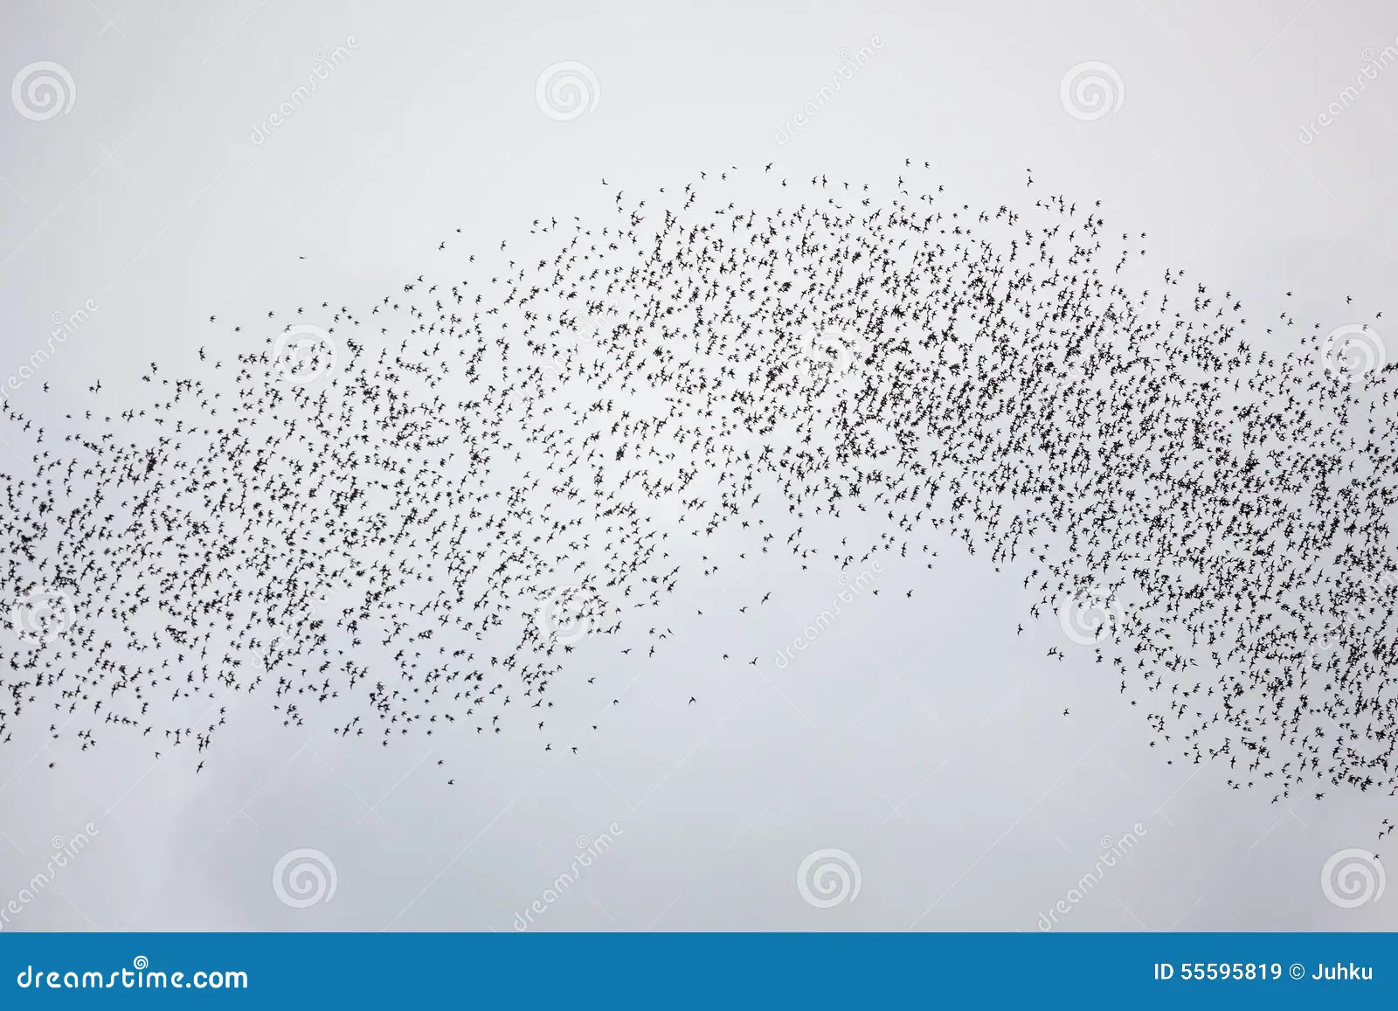
PARTICLE SWARM OPTIMIZATION
The PSO algorithm is an intelligent population-based stochastic optimization technique that simulates behavior of a natural biological swarm.
Each particle is potential solution in search space, and it updates its velocity and position, based on historical best position pbest, where received highest NSS.
Note: in our implementation each particle is a UAV.
Modified PSO
Divide swarm into M groups, the gbest is referred to the best position of each group, not of the whole population. We are separately able to catch multiple optima, overcoming the limitation of the standard PSO.

Slide 9
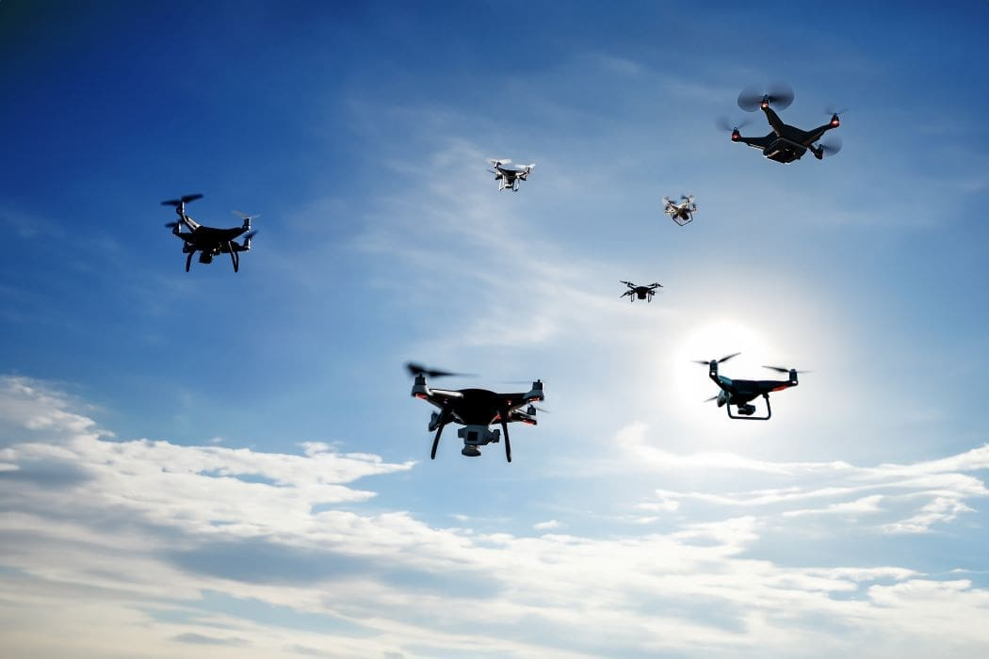
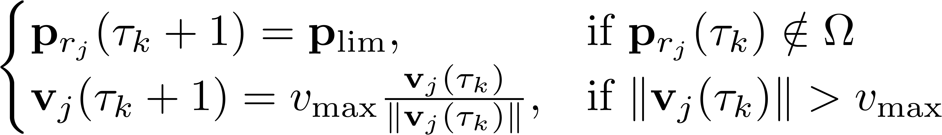
UAV SWARM
Persistency of Excitation
Uniform random noise is added to the velocity of each particle
to achieve persistence of excitation,
allowing every UAV to explore different directions and
keep the UAVs from getting stuck in local optima:
Conditions
UAVs are confined to the search space and
their velocity is capped to a max value to avoid speed ”explosion”:

Slide 10



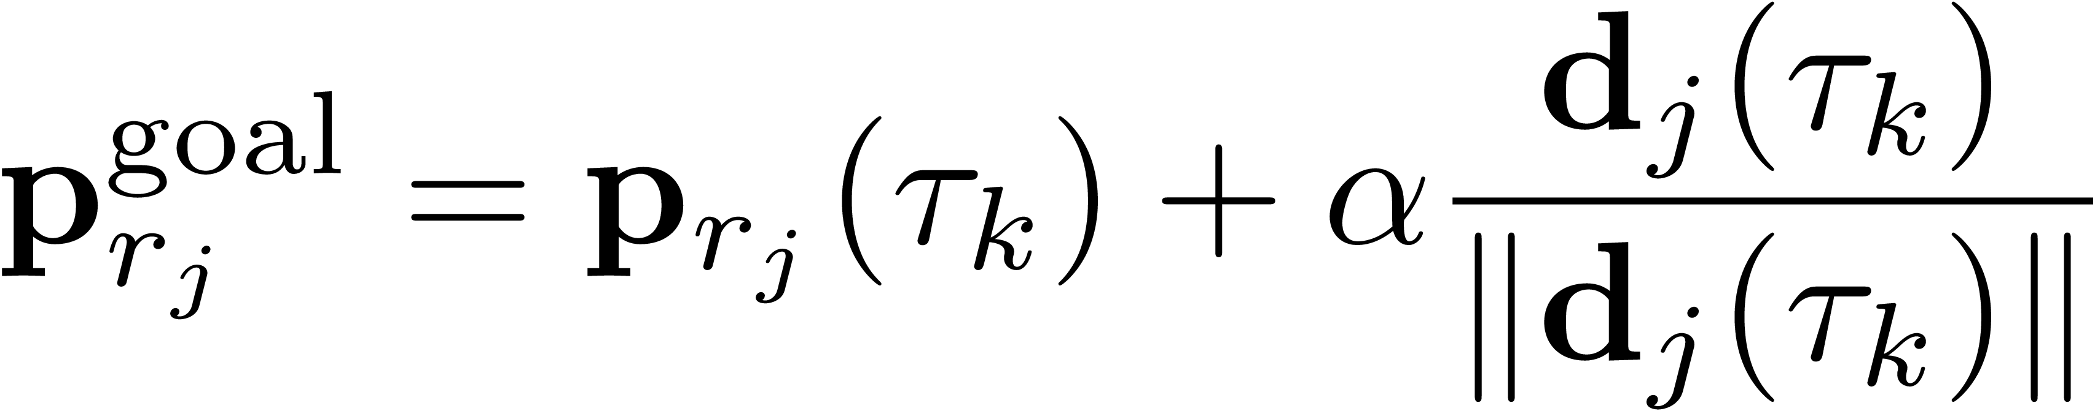
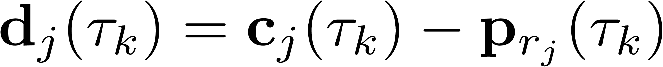
EXCLUSION ZONE MECHANISM
Generation of exclusion zone when NSS greater than a threshold, the exclusion zone is:
Sharing the exclusion zone between UAVs when in communication radius:
Avoidance by moving far away from the zone:

Slide 11
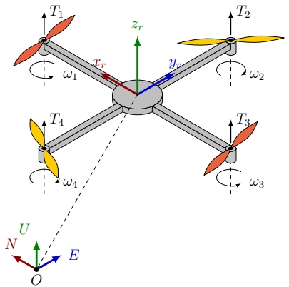
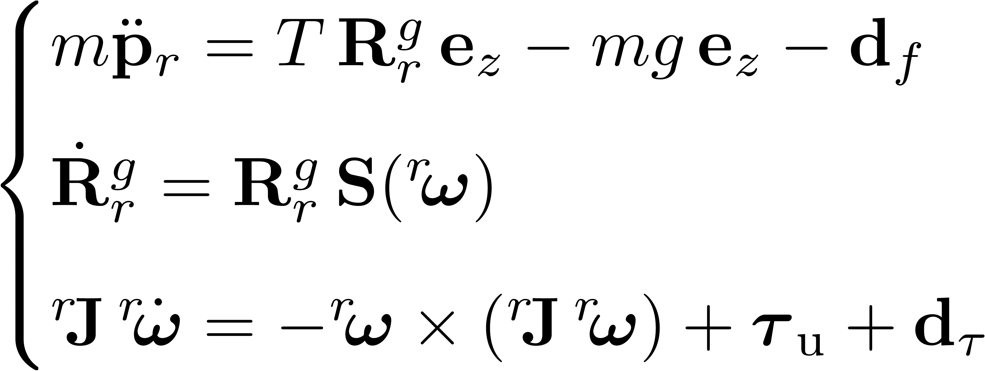
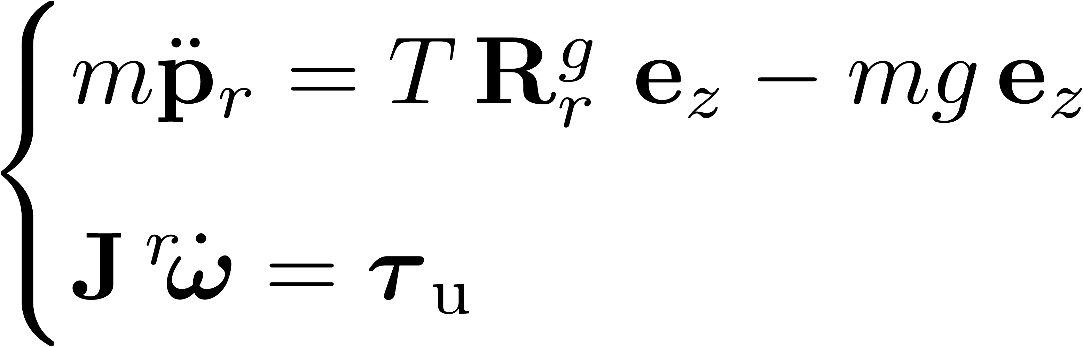
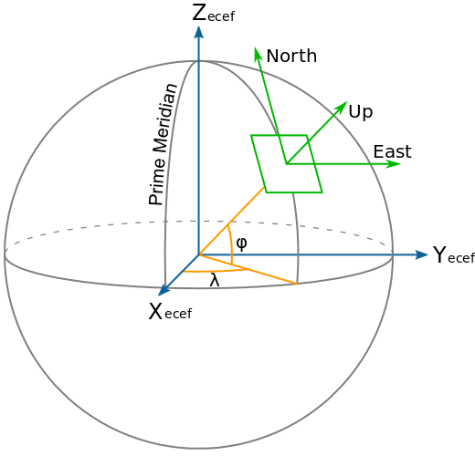
UAV DYNAMICS
Small angle approximation
Simplified dynamics used for the
determination of PID control laws.

Slide 12
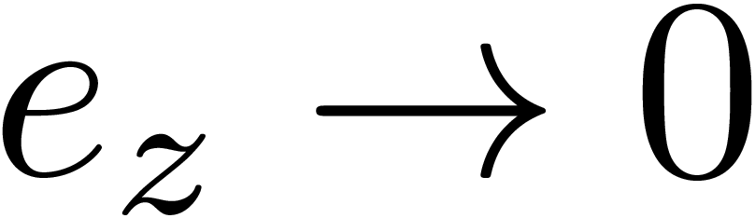
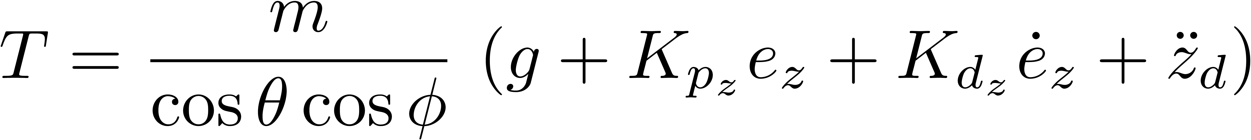
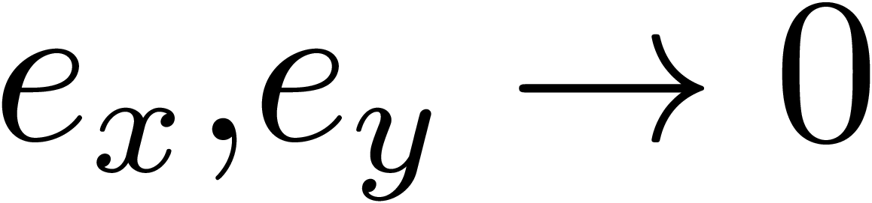
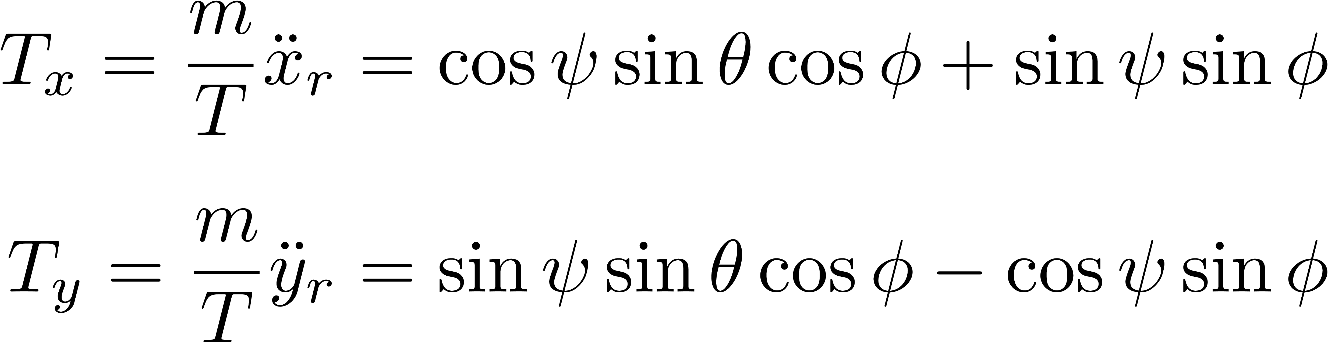
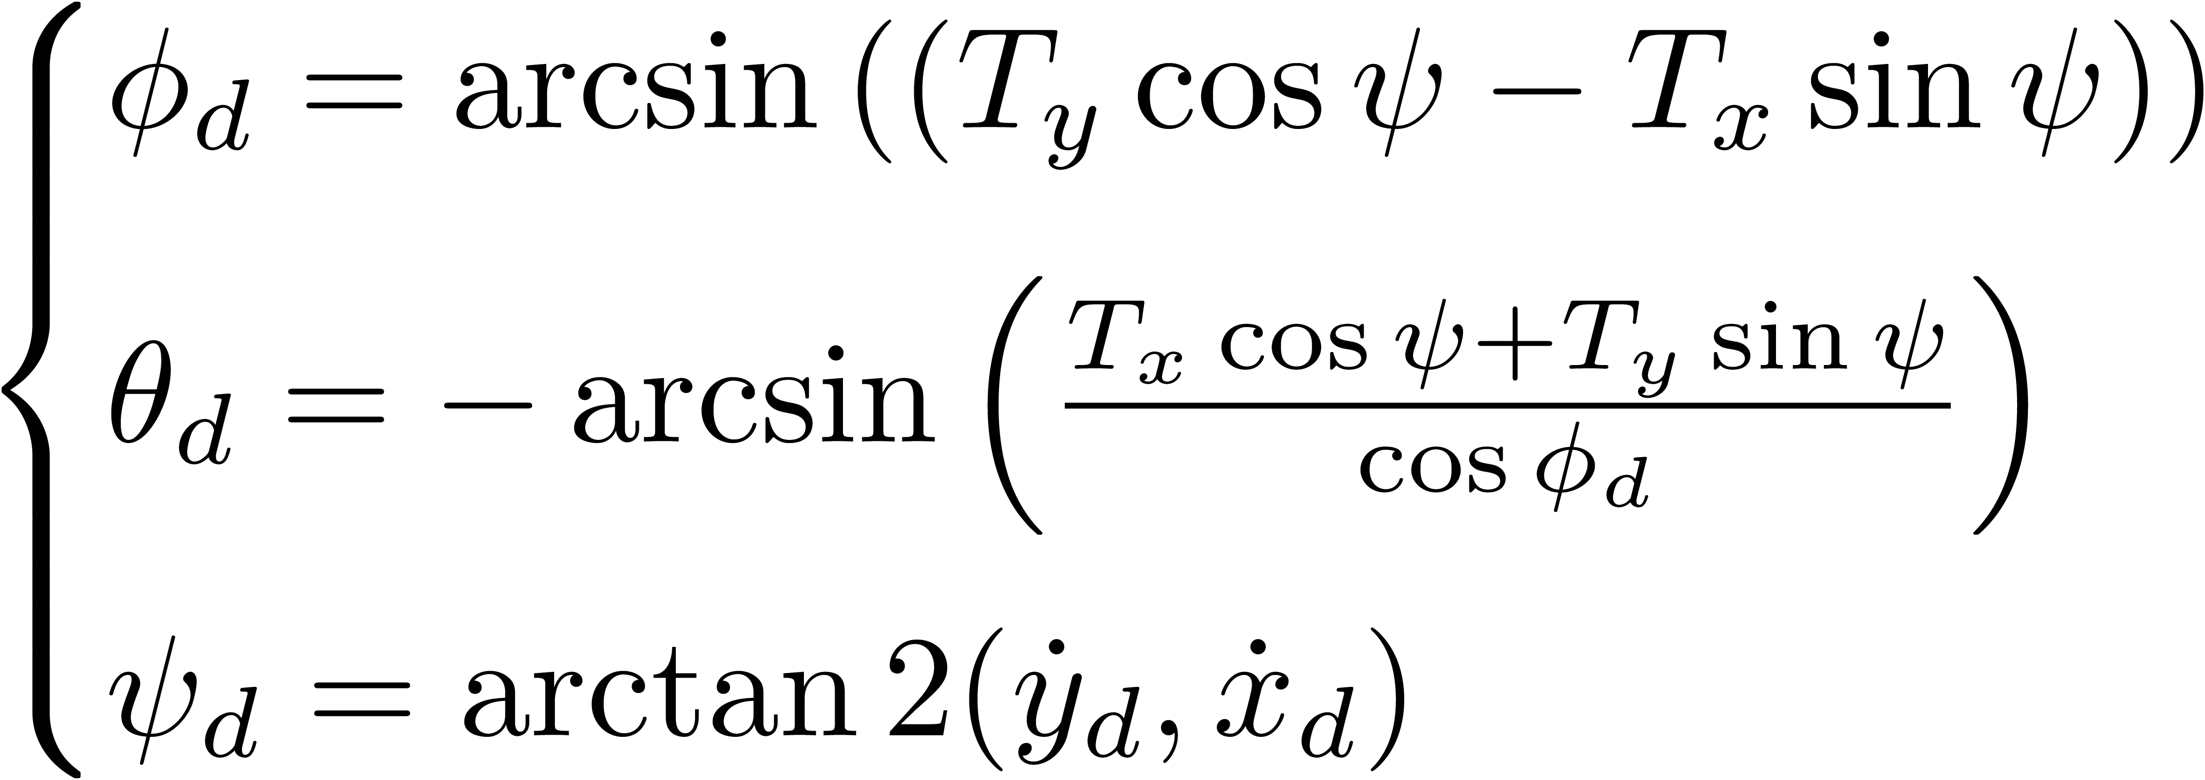
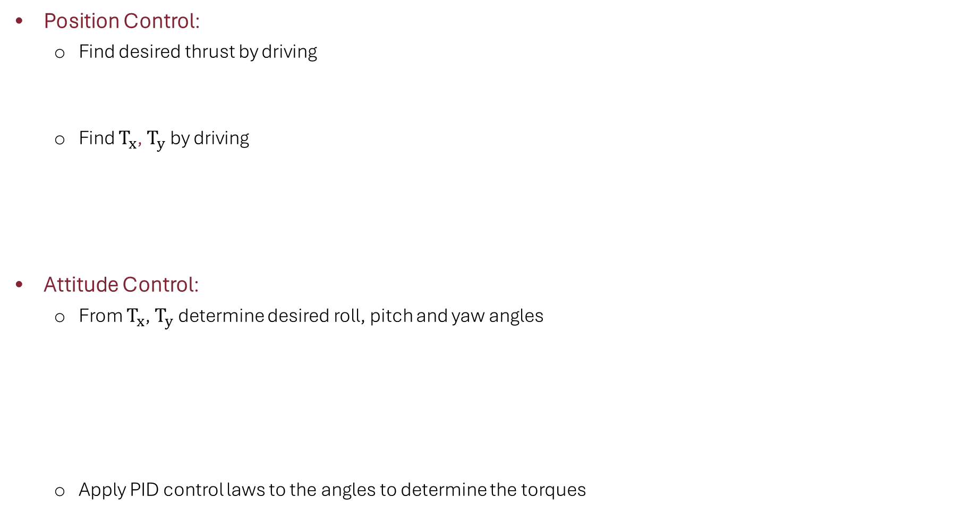
PID CONTROL
Position Control:
Find desired thrust by driving
Find $T_{x}$, $T_{y}$ by driving
Attitude Control:
From $T_{x}$, $T_{y}$ determine desired roll, pitch and yaw angles
Apply PID control laws to the angles to determine the torques

Slide 13
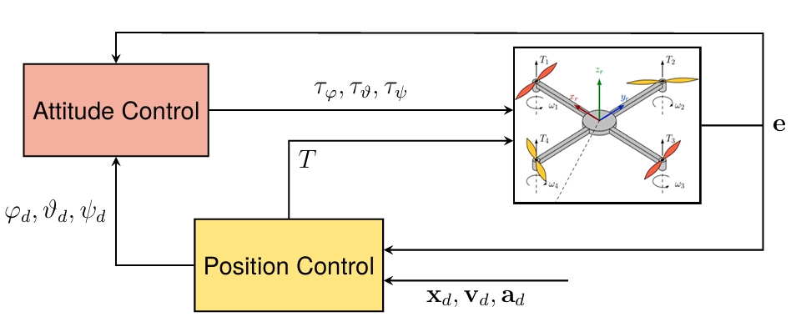
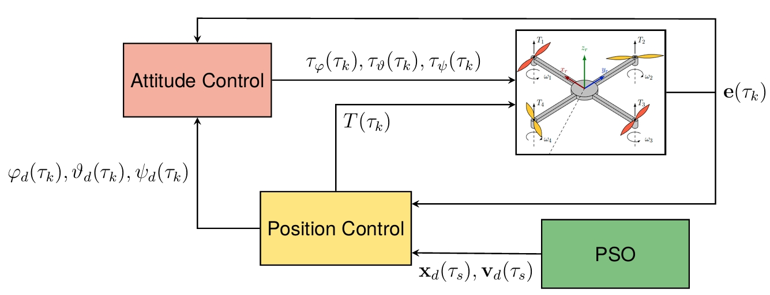
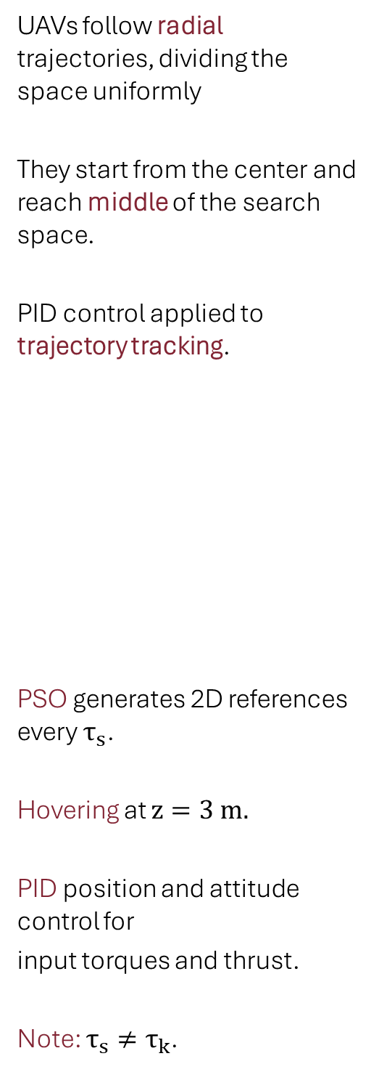
EXPLORATION PHASE
The complete algorithm is divided into 2 phases.
UAVs follow radial trajectories, dividing the space uniformly
They start from the center and reach middle of the search space.
PID control applied to trajectory tracking.
PSO generates 2D references every $τ_{s}$.
Hovering at $z=3 m.$
PID position and attitude control for
input torques and thrust.
Note: $τ_{s}≠τ_{k}$.

Slide 14
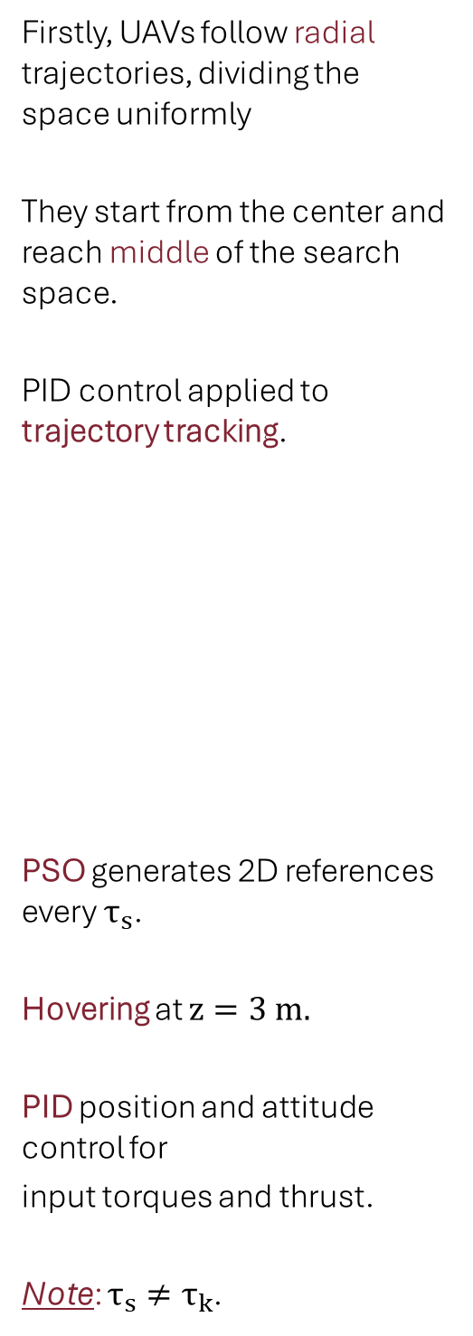
Firstly, UAVs follow radial trajectories, dividing the space uniformly
They start from the center and reach middle of the search space.
PID control applied to trajectory tracking.
PSO generates 2D references every $τ_{s}$.
Hovering at $z=3 m.$
PID position and attitude control for
input torques and thrust.
Note: $τ_{s}≠τ_{k}$.
EXPLOITATION PHASE
The complete algorithm is divided into 2 phases.

Slide 15
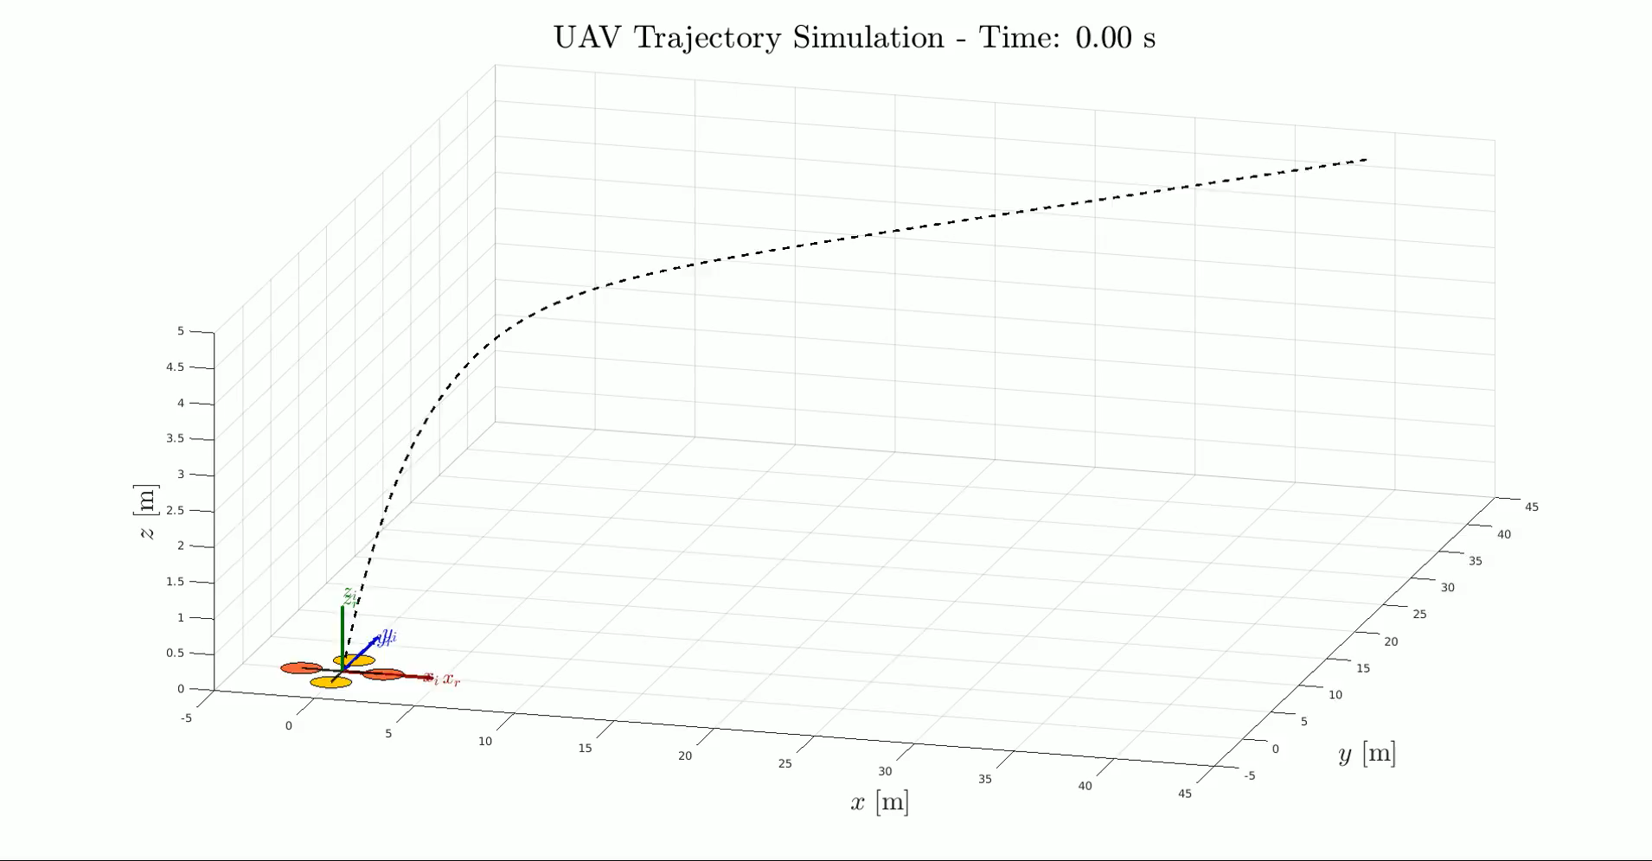
EXPLORATION PHASE: Single UAV 3D View

Slide 16
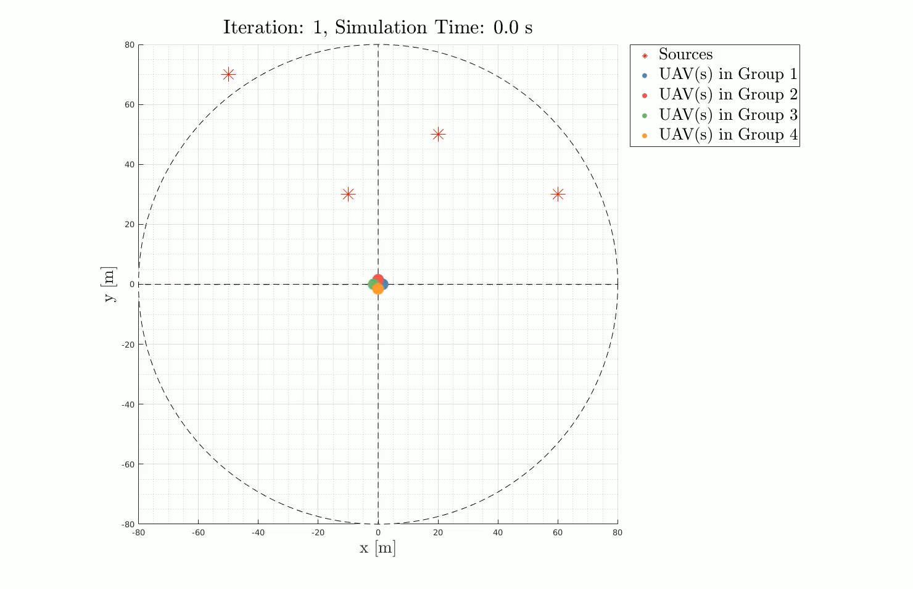
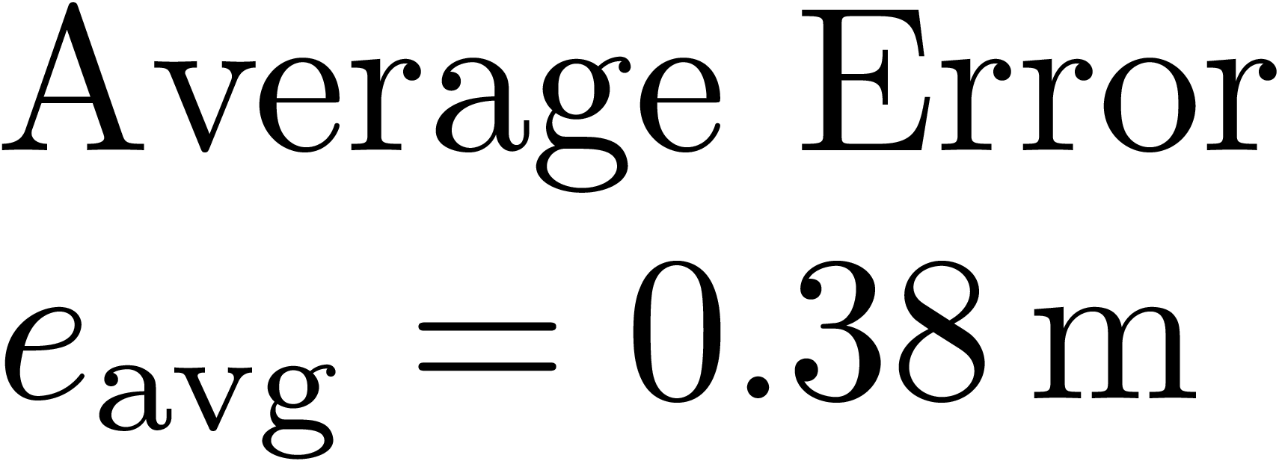
CASE 1: Exploration & Exploitation
4 UAVs
4 victims randomly positioned

Slide 17
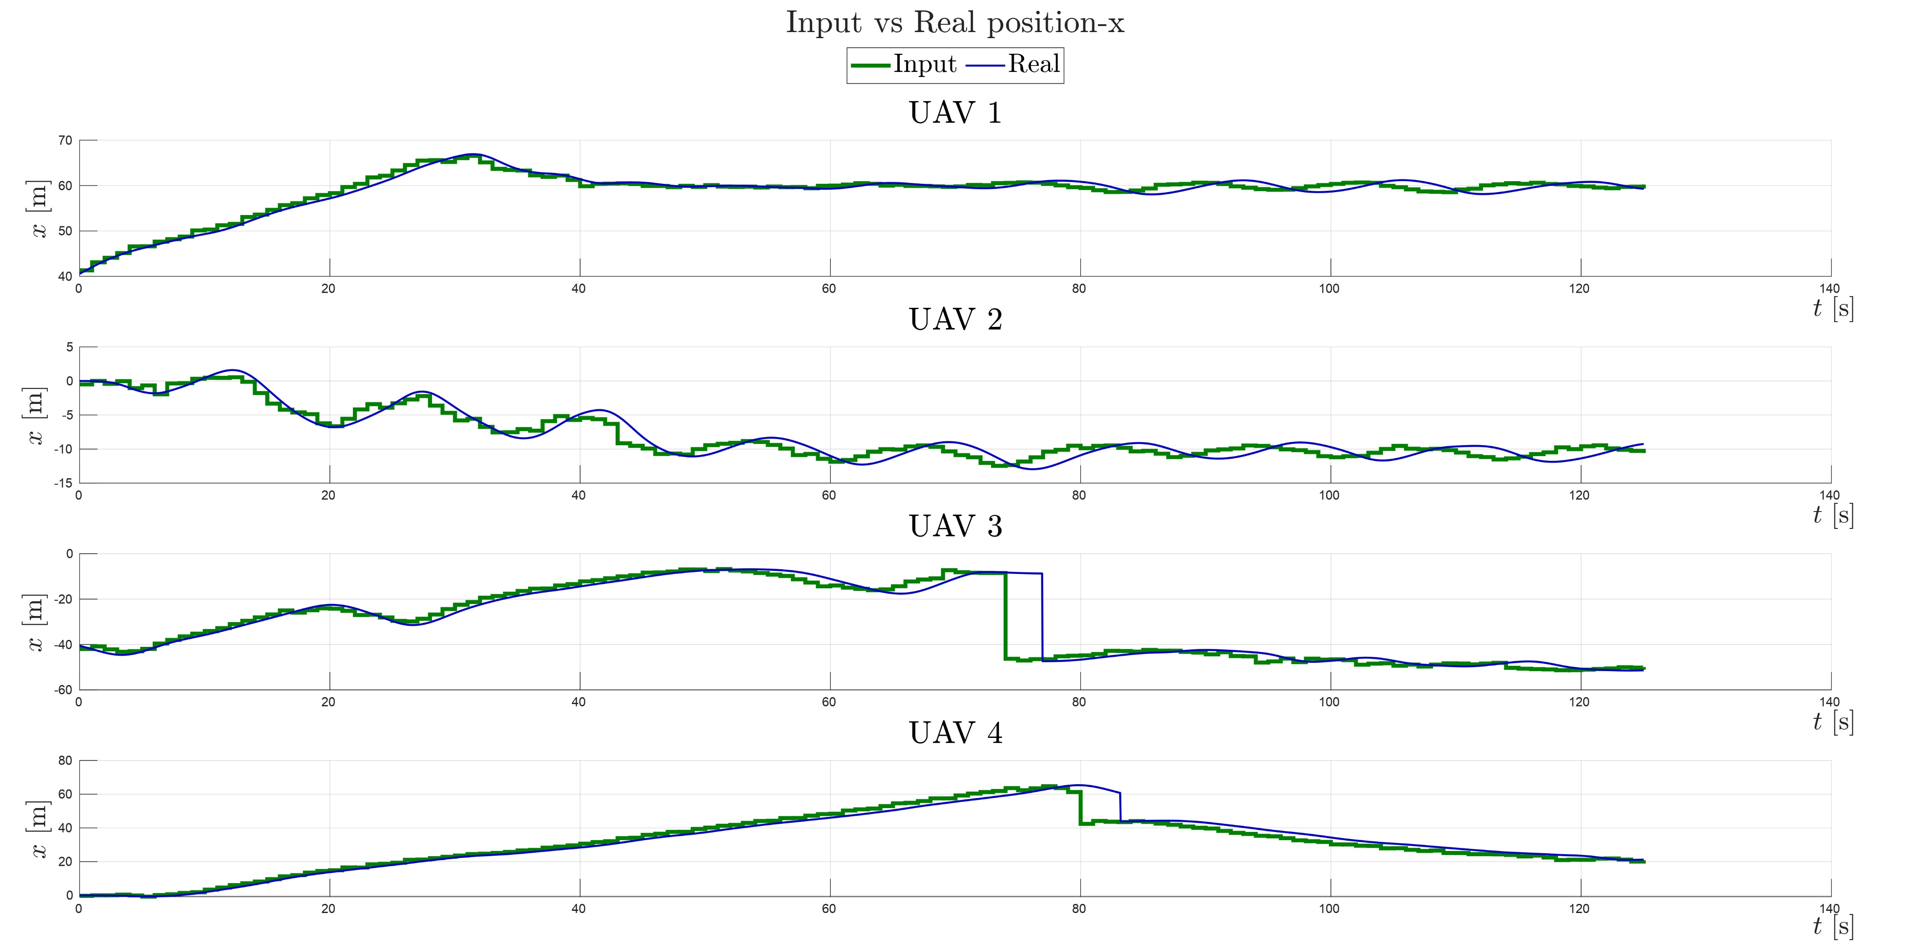


CASE 1: Reference vs Actual Position x
Notes:
No input ma reference e actual

Slide 18
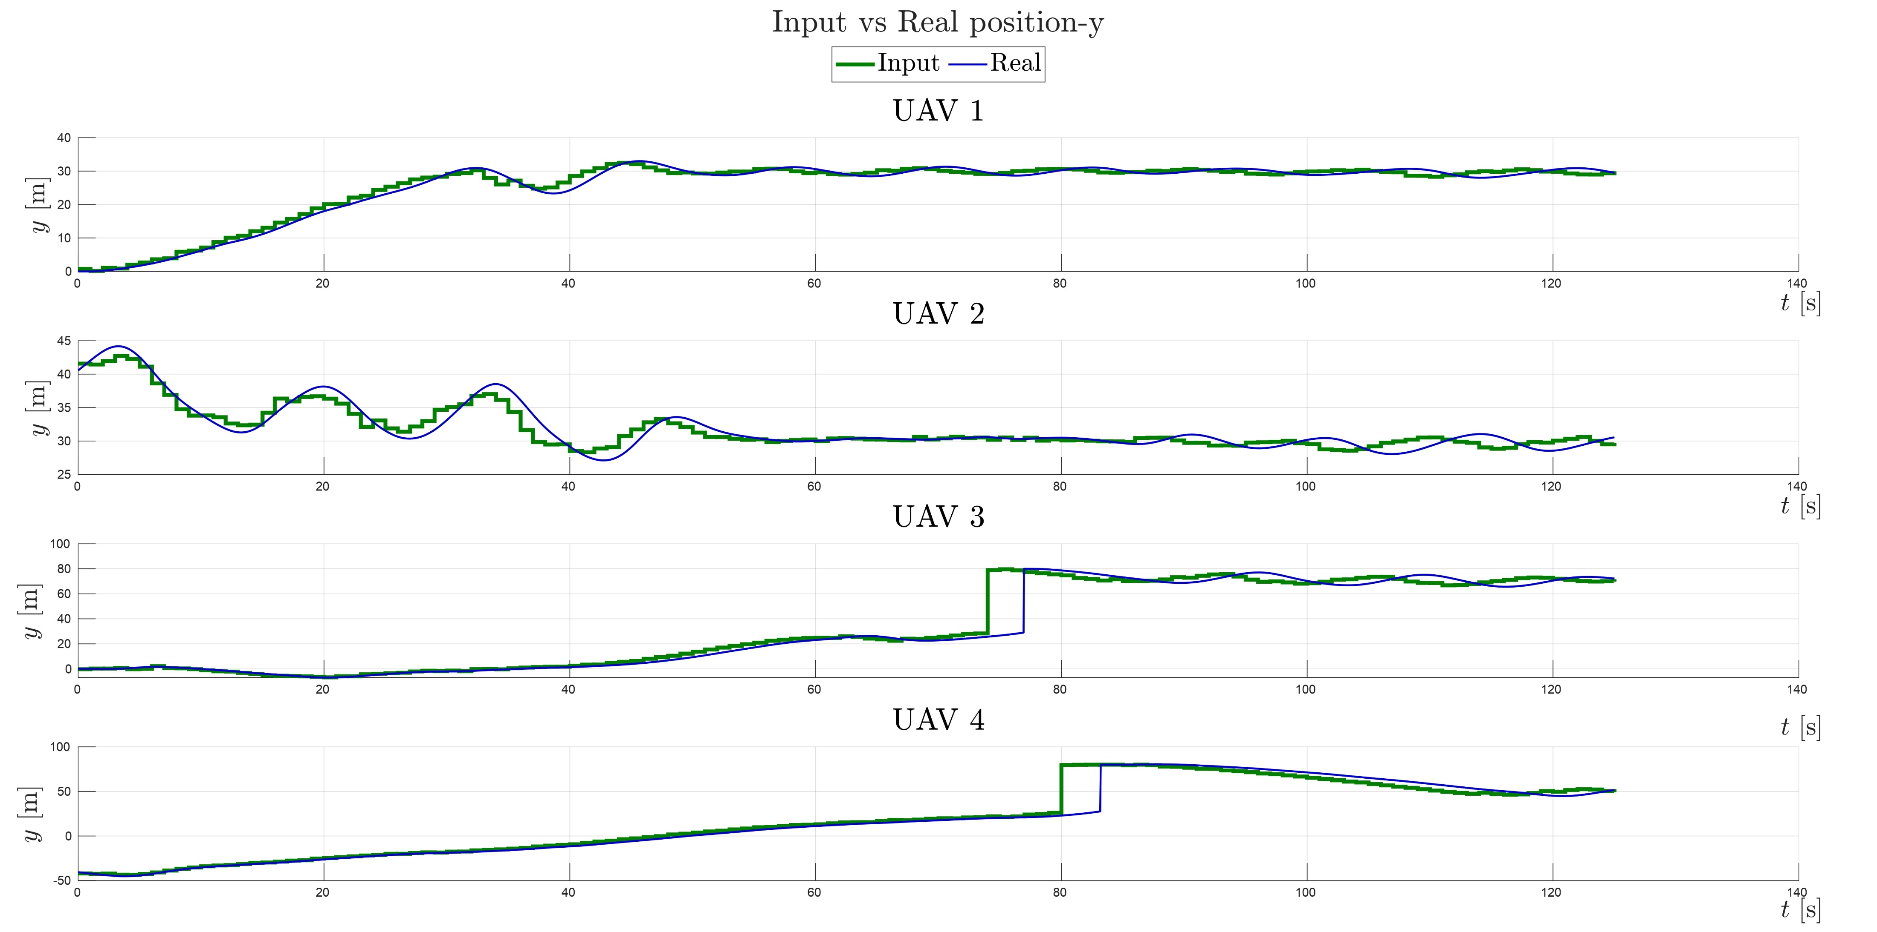
CASE 1: Reference vs Actual Position y

Slide 19
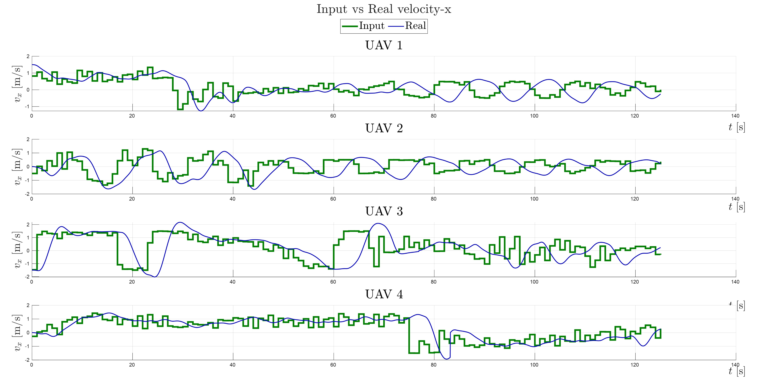
CASE 1: Reference vs Actual Velocity x

Slide 20
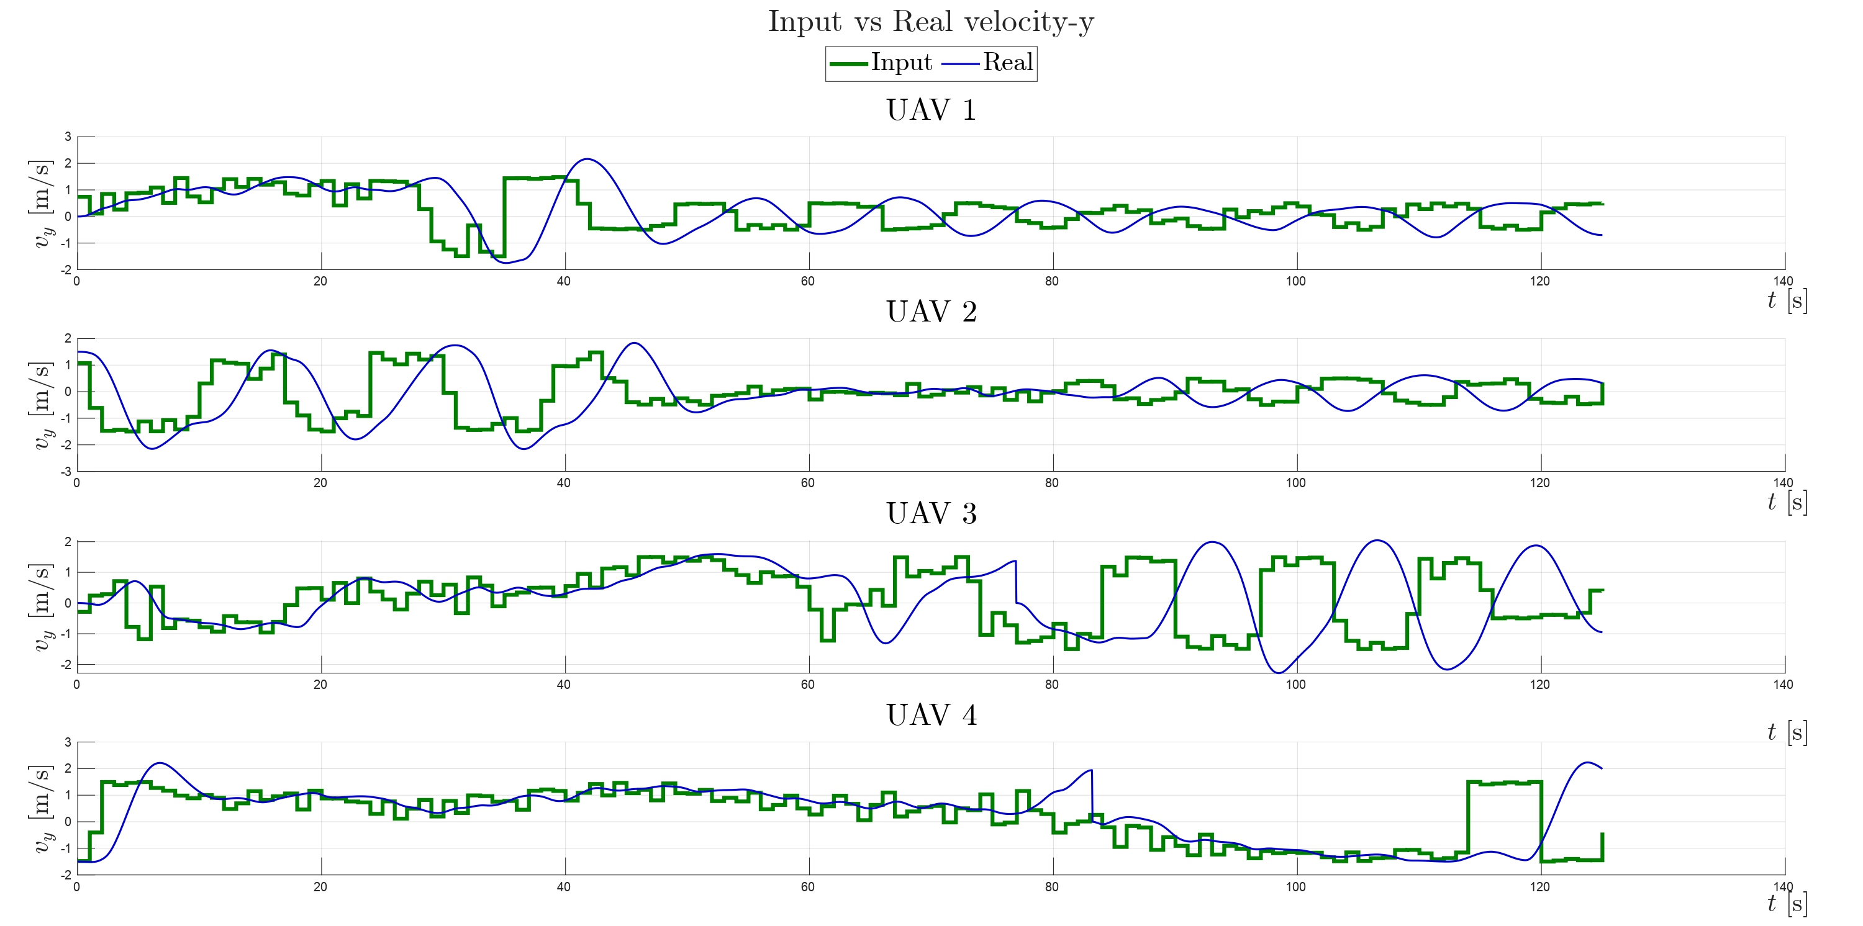
CASE 1: Reference vs Actual Velocity y

Slide 21
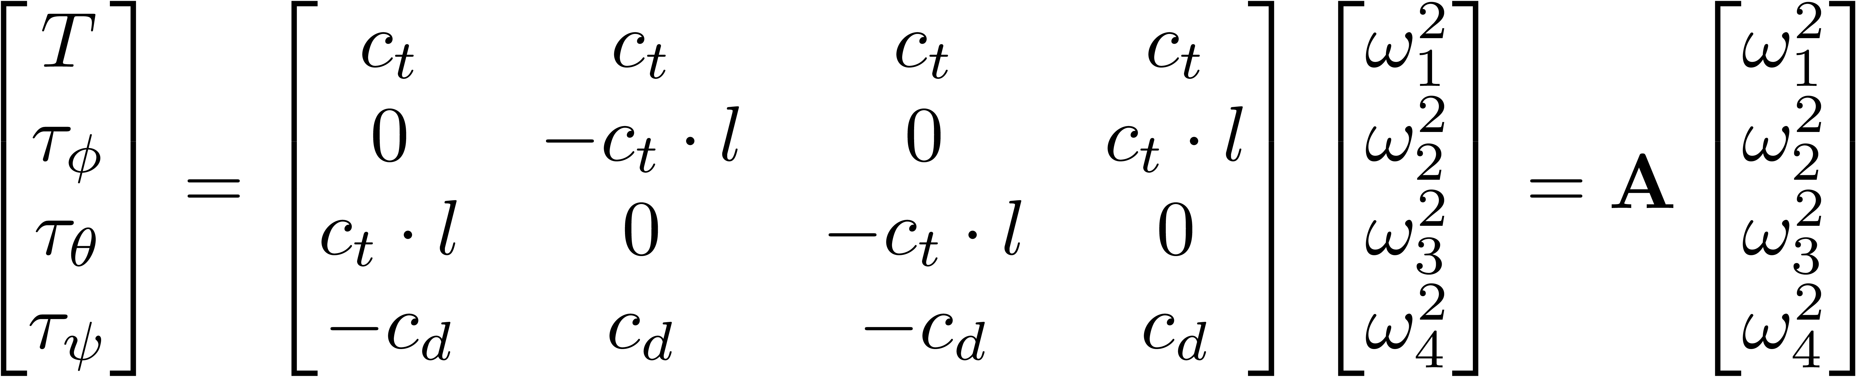
ROTOR VELOCITIES
Invert A and compute square root to find actual controllable inputs.
Physical parameters taken from real Draganfly IV quadrotor.
Notes:
Rotor velocities hide the slide

Slide 22
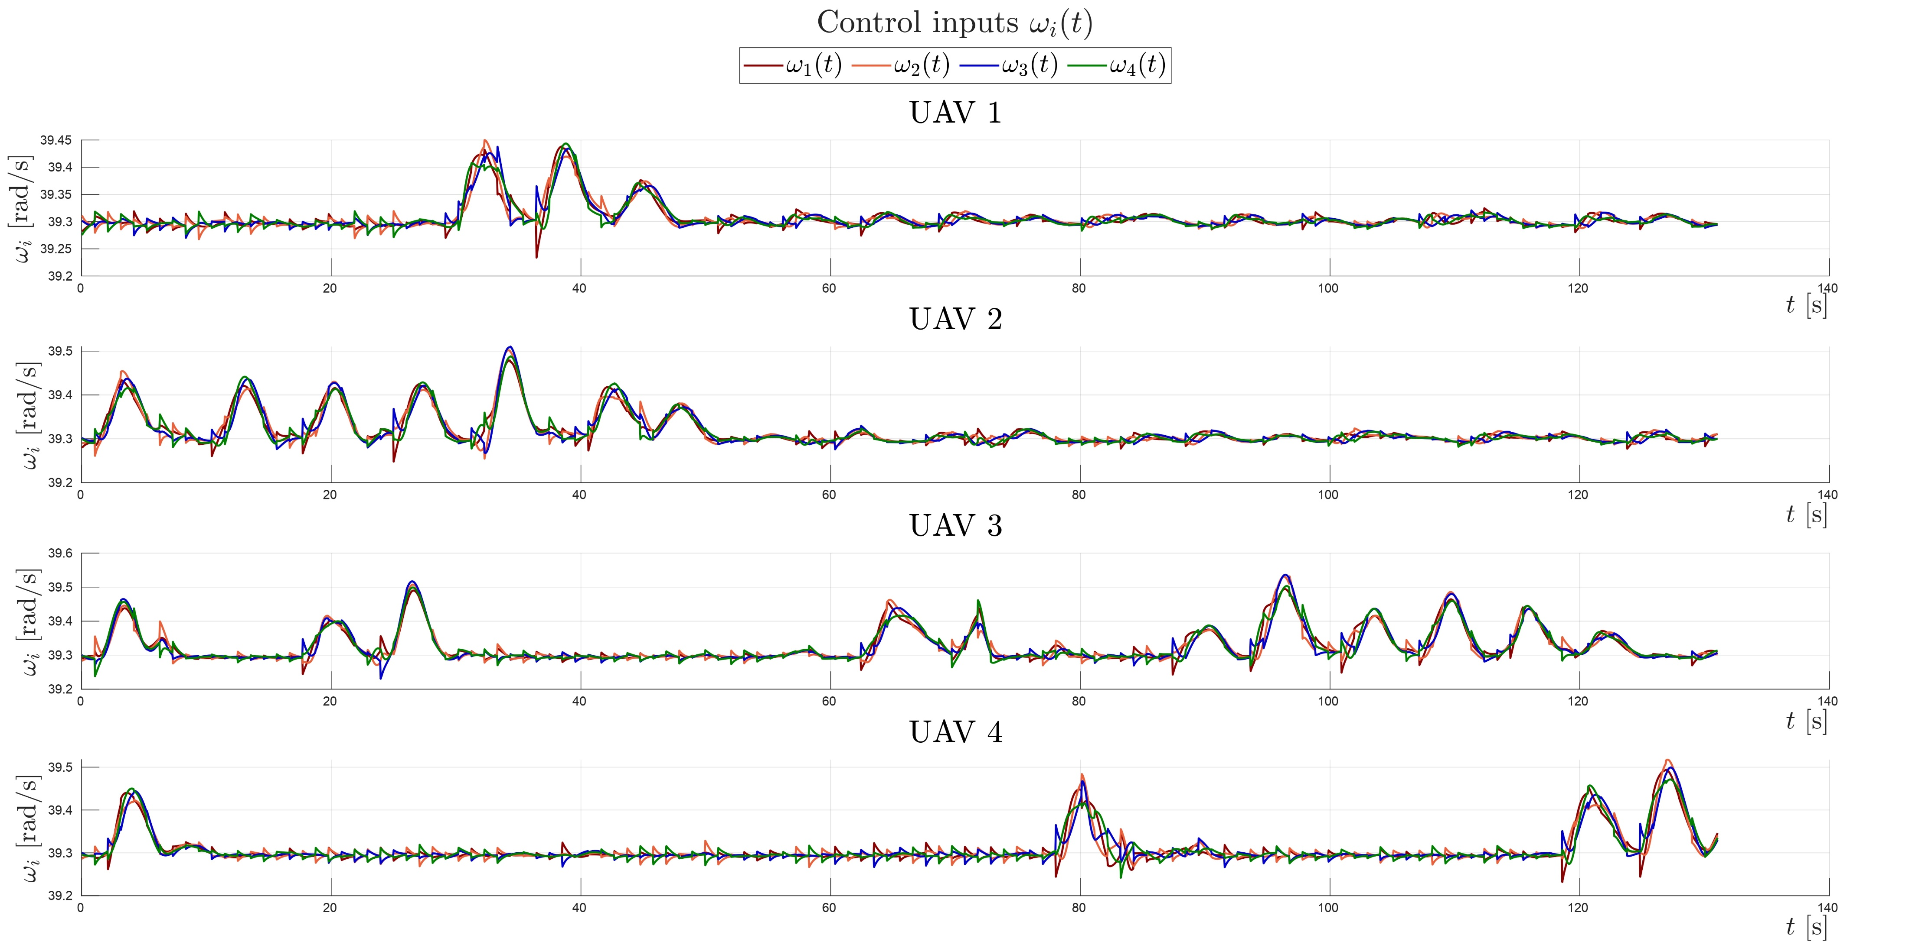
CASE 1: Rotor Velocities

Slide 23
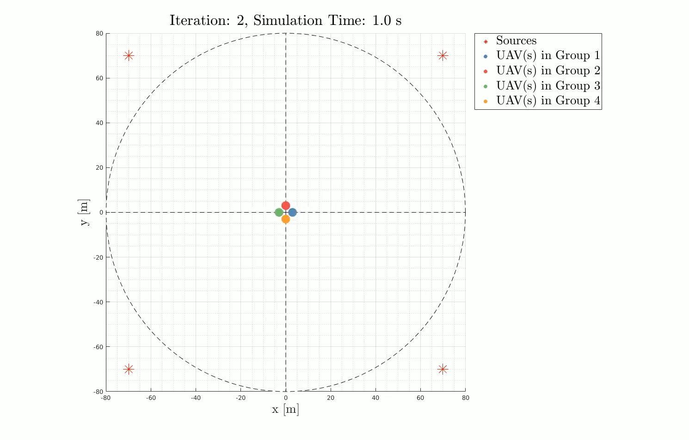
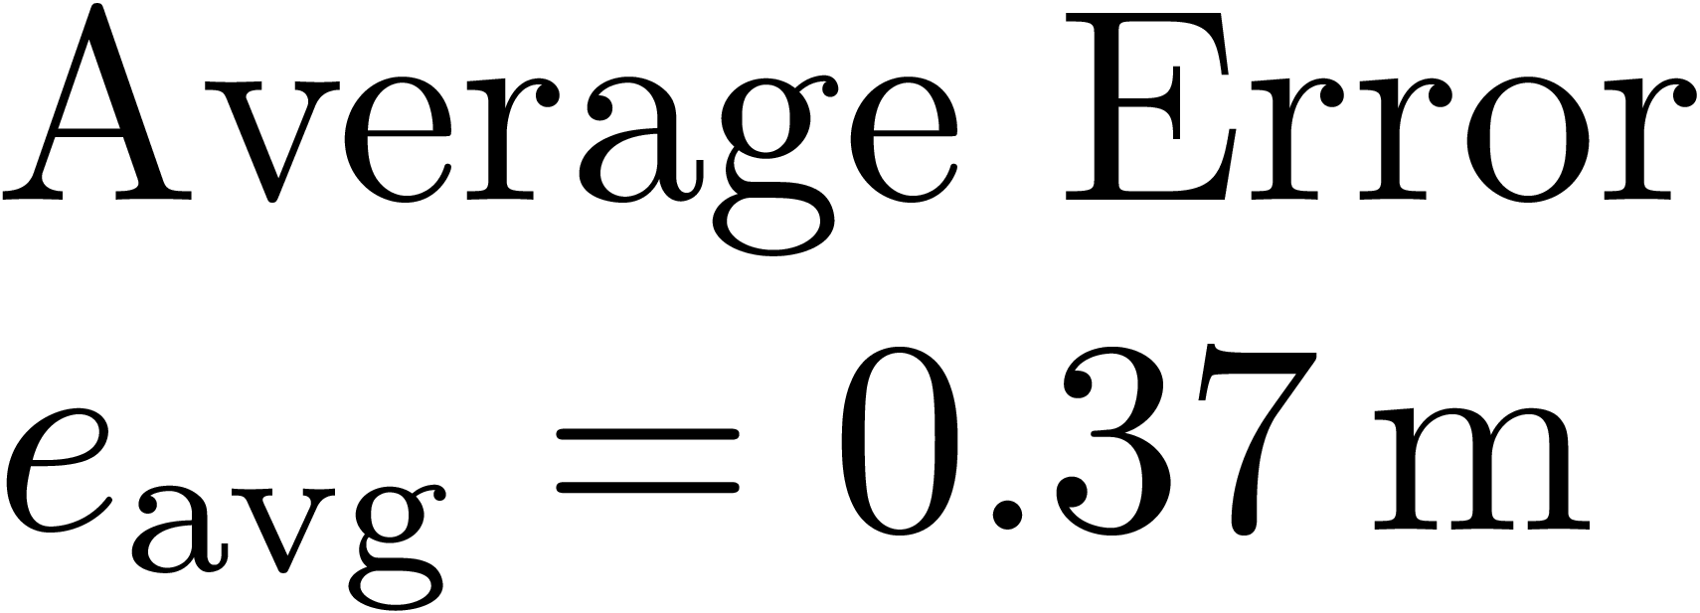
CASE 2: Exploration & Exploitation
4 UAVs
4 victims positioned at the corners

Slide 24
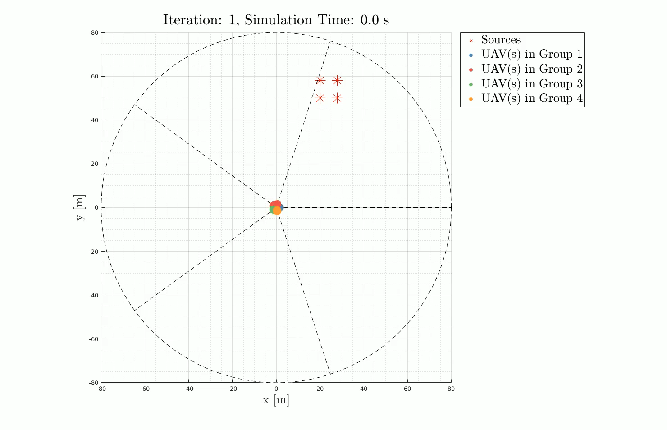
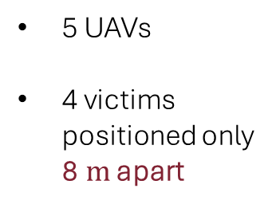
CASE 3: Exploration & Exploitation
5 UAVs
4 victims positioned only 8$m$ apart

Slide 25
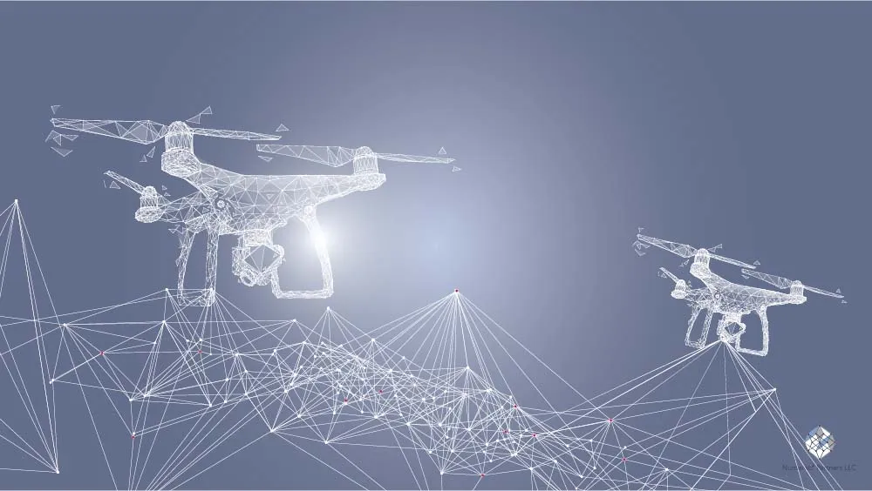

CONCLUSIONS
We have developed a solution to the multi-source localization problem, a challenging task due to the superposition of multiple signals.
By using a decentralized approach which is less computationally intensive, and it is particularly useful in scenarios where communication is difficult.
The control task was not the focus of the work and could be improved by employing more accurate methods (e.g., geometric control).
Improvement could be made in adding disturbances to both signal generation and the control task to see the robustness of the approach.
Notes:
We have analyzed in depth the signal generation and developed a modification of the PSO algorithm that works in different cases.

